Slide 1
BattleChess
First Release Presentation

Slide 2
USER STORIES
-As the user I will be playing Chess.
-As the user I want to be able to register for the game.
-Registration: Save the user's info into the database
-As the user I want to be able to login to the game.
-Login: Request the user login information from the database
-When the user logins in, put them in a game if one is available, if not create a new game and wait for another user.
-As the user I would like to be notified when to start playing.
-In order for the gameplay to successfully take place the pieces should have the functionality to move.

Slide 3
USER STORIES
--If moves are attempted outside of normal chess restrictions, I as the user should be prompted with an error message and the pieces should be reset to the last valid position.
-In order to keep players honest, as the user I’d like have separate boards for each player limiting each player to only moving his/her pieces.
-As the game gets closer to an end, I should be notified when I’ve been placed in check or placed my opponent in check and then checkmate.
-Lastly, after a successful checkmate I’d like to be notified that I’ve won and see my ranking, wins and losses.
-At the end of the game, I should have the option to restart or quit.
--When moving pieces they should be restricted to only true chess moves.

Slide 4
User Stories implement in First Release
-As the user I will be playing Chess.
-As the user I want to be able to see all the buttons fro the game: register, skip, login, credits, and rankings.
-As the user I want the skip button to allow me to see the board.

Slide 5
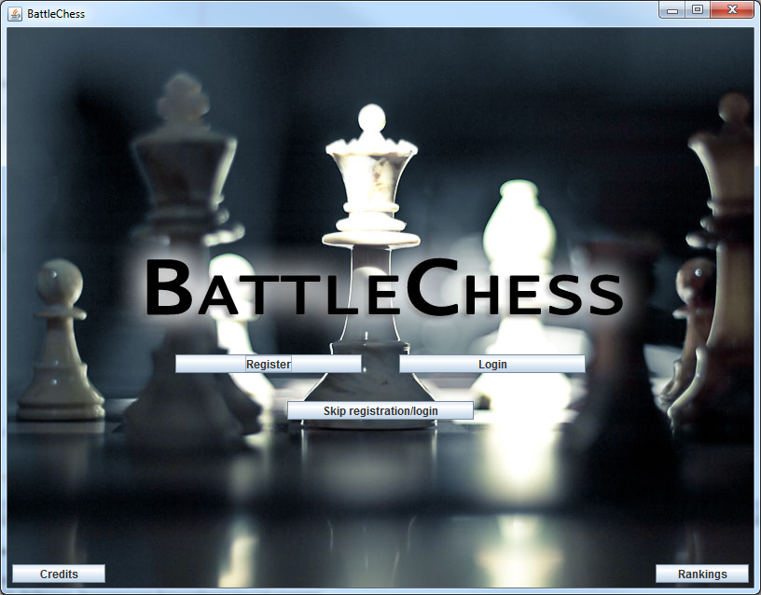

Slide 6
Test Cases
We used Junit for testing.
We wrote code to test that our CreateScreens, CreateTitle, CreateRegistration, CreatLogin, CreateBoard, CreateCredits, and CreateRankings methods were working correctly.
Within all of these methods we have buttons, so we tested the buttons two different ways.
One form of testing the buttons was with Junit Coding.
The other was physically clicking on the buttons.

Slide 7
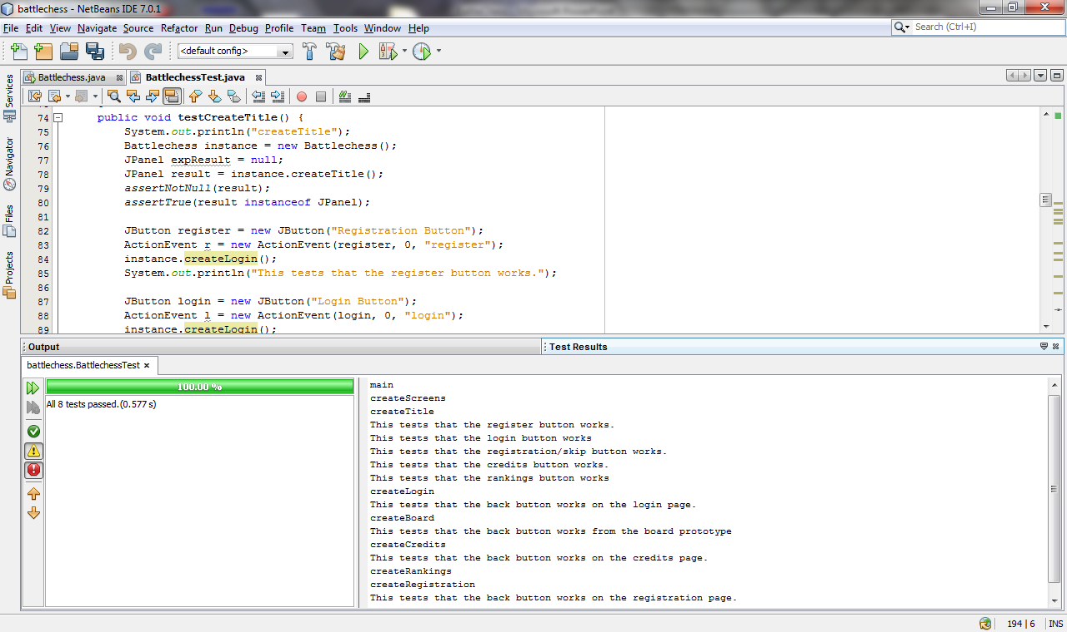

Slide 8
Current Status of the Game
Currently when our game runs, you see the title page which gives you five options: Register, Login, Registration/Skip, Credits, and Rankings.
Each of these buttons takes you to a different page.
If you’d like to go back to the Title page, there is a back button in the top left corner.
Also the Registration/Skip button allows you to go straight to the Chess Board.

Slide 9
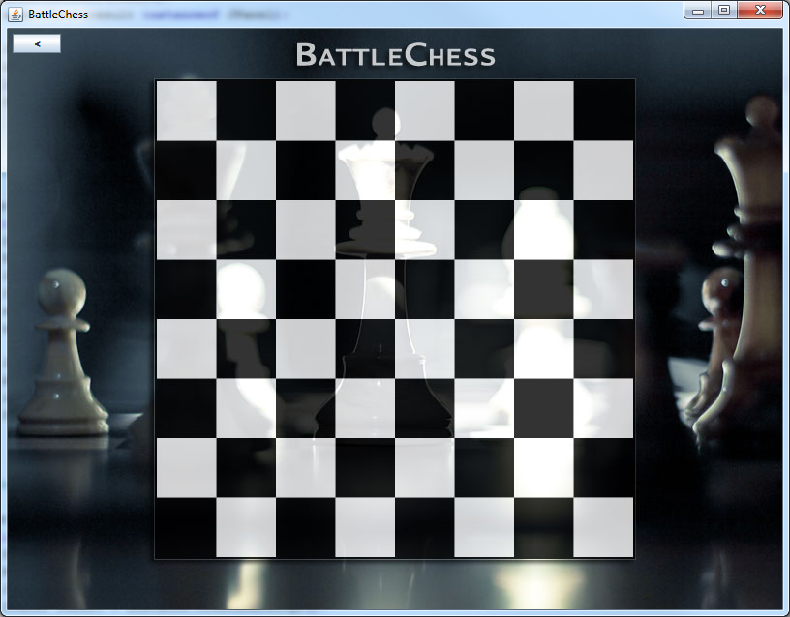
Demo of First Release

Slide 10
Plan for Next Release
Add pieces to the board
Allow input from the user for registration and login purposes.

